Slide 1


A question to start with…
On average, what does every single one of us in this room do...
• 14 times a minute?
• 840 times an hour?
• Over 20,000 times a day?
• At least 7 million times a year?

Slide 2

Breathe!
Most of us take breathing for granted. We do it all the time, without even thinking about it.
Take a deep breath now. Breathe in and out...
Think about which body parts are helping you to breathe.
Can you feel your rib cage?

Slide 3



Slide 4
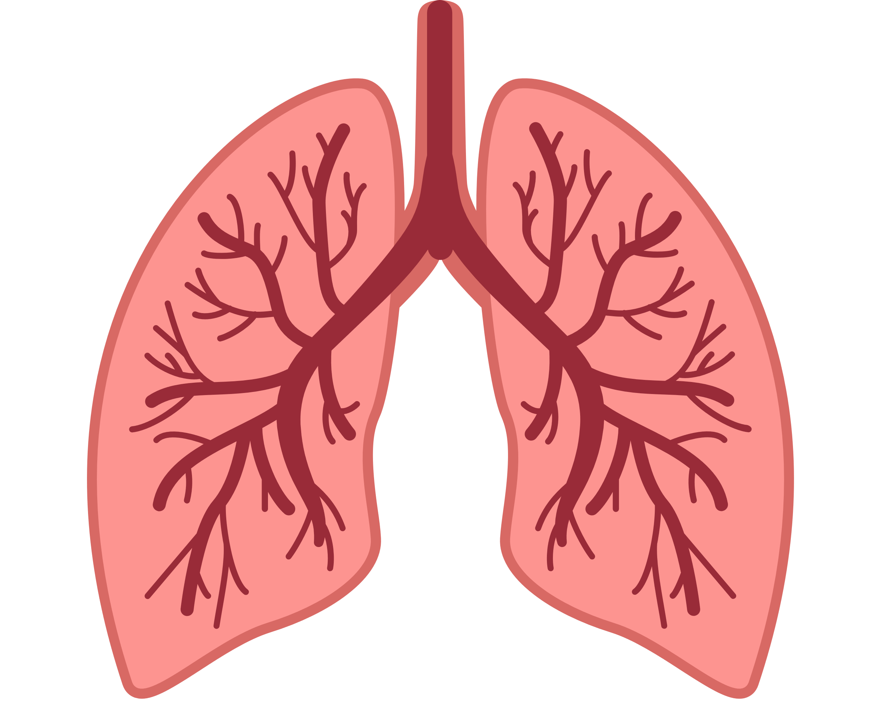
What are lungs?
The lungs are really important organs in the human body. They're in our chest, protected by our rib cage. Like other body parts, they grow bigger as you get older.
The lungs' job is to get oxygen from the air we breathe in into our blood. They are a bit like two balloons, taking in fresh air and getting grid of old, stale air.
Unfortunately, there are many illnesses and conditions that affect the lungs. These illnesses can make breathing more difficult.

Slide 5
Raise your hand if you've ever heard of...
Coronavirus
Long COVID
Asthma
Cystic fibrosis
Pneumonia
Lung cancer
Tuberculosis
These are all lung conditions.

Slide 6
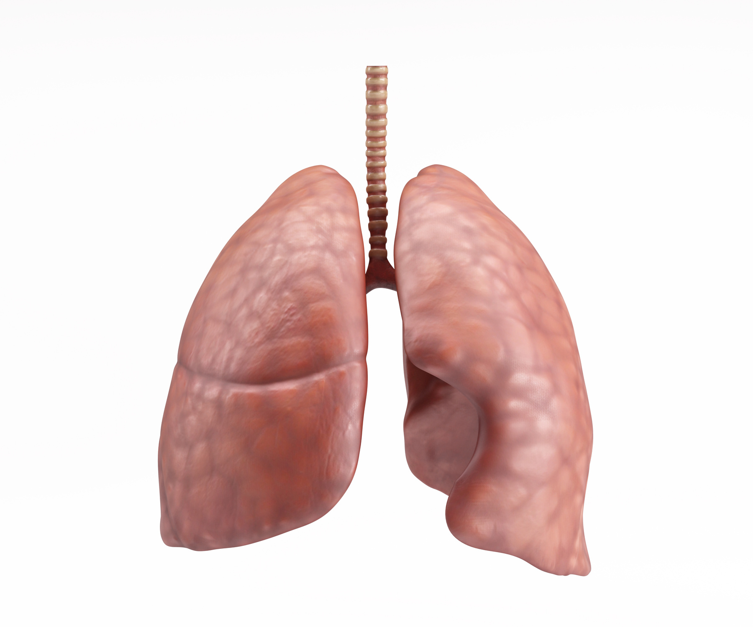
Lung conditions
There are lots of different lung conditions. Some are quite common and affect lots of people. Others are a lot more rare.
Let's learn a bit about the more common lung conditions. You might already know about some of these.

Slide 7

Asthma

Slide 8
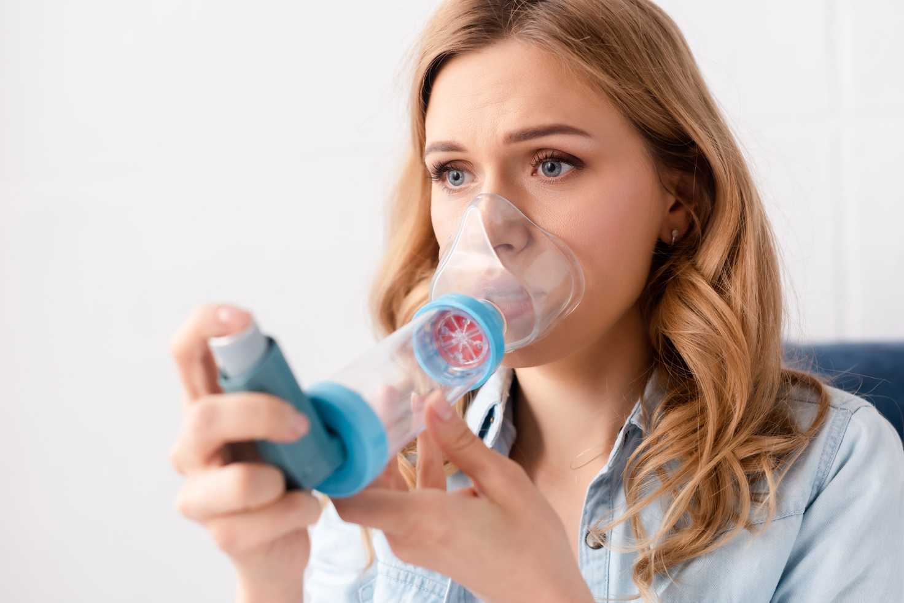
Asthma is a very common lung condition
Meet Emily. They have asthma. They use an inhaler and a spacer to manage their asthma. This means they can join in with all the activities they love to do.
• Asthma affects the airways that carry air in and out of your lungs.
• In the UK, 5.4 million people have asthma. That's one in every 12 adults and one in every 11 children.
• There’s no cure for asthma, but there are tried and tested asthma medicines to prevent symptoms.
• These medicines mean most people with asthma can carry on with their lives without asthma symptoms getting in the way.
• However, asthma attacks can be triggered by air pollution, pollen, colds and viruses, pets and stress, among other things.

Slide 9
Cystic fibrosis

Slide 10

Cystic fibrosis is a hereditary lung condition
Meet Luke. They have cystic fibrosis which means they often have sticky mucus in their lungs. They have check-ups with special nurses and doctors. They learn about how to keep their lungs healthy and they take medicine if they need it.
• Cystic fibrosis (CF) is a condition caused by genes that are inherited from parents.
• CF is most often diagnosed in newborn babies.
• Life with CF can be challenging but treatments, diet and physiotherapy mean most school-age children with CF are quite healthy and can join in all activities.
• However, studies have shown that environmental factors such as air pollution can make CF symptoms worse.

Slide 11
COPD
(chronic obstructive
pulmonary disease)

Slide 12

COPD is a common lung condition
Meet James. They have COPD which makes it hard to breathe. One of the treatments they use is oxygen therapy.
• It is the name for a collection of lung conditions, including chronic bronchitis, emphysema and chronic obstructive airways disease.
• COPD mainly affects middle-aged or older adults who smoke or have smoked.
• People with COPD have difficulties breathing. This is mainly due to the narrowing of their airways (or airflow obstruction).
• The damage to the lungs is permanent and there is no cure for COPD, but treatment can help slow the progression of the condition.

Slide 13
Pneumonia

Slide 14

Pneumonia (pronounced new-moan-ee-a) is a type of chest infection
Meet Nia. The doctor is listening to their chest and will prescribe some medication to fight off the infection.
• Pneumonia causes tiny air sacs in the lungs to become swollen and fill with fluid.
• This makes breathing difficult.
• Most people make a full recovery from pneumonia, but it can be dangerous.
• It can be caught in a variety of ways but air pollution increases the risk of infection.

Slide 15
Tuberculosis

Slide 16

Tuberculosis is caused by a bacterial infection of the lungs
• 150 years ago, tuberculosis (TB) was the main cause of death in Britain and one in eight people died from the disease.
• A combination of vaccinations, medication and increased awareness means that most people can be treated and make a full recovery.
• But TB has not gone and should not be forgotten. It still infects around 5,000 people in the UK every year.
• If it is not identified and treated early, it can still be very dangerous.
Meet Kenny. They are poorly with tuberculosis. The hospital staff are helping them to get better.

Slide 17
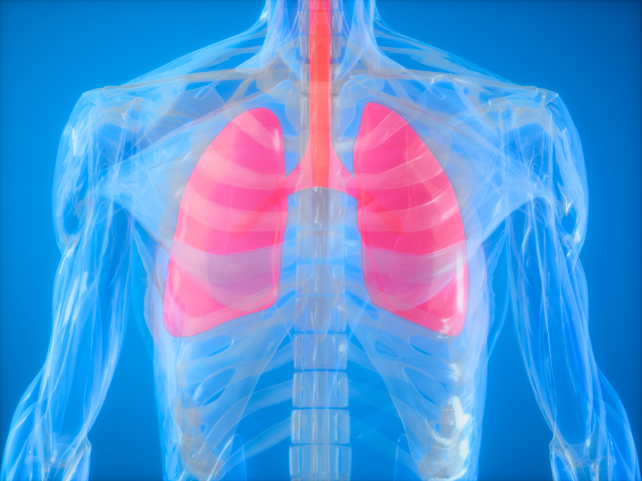
Healthy lungs

Slide 18

Asthma + Lung UK
Asthma + Lung UK is the UK's lung health charity.
The charity supports people with lung conditions and gives advice.
They raise money to help with research to find new ways to diagnose, treat and cure lung conditions.
They also investigate air quality and fight for cleaner air.

Slide 19
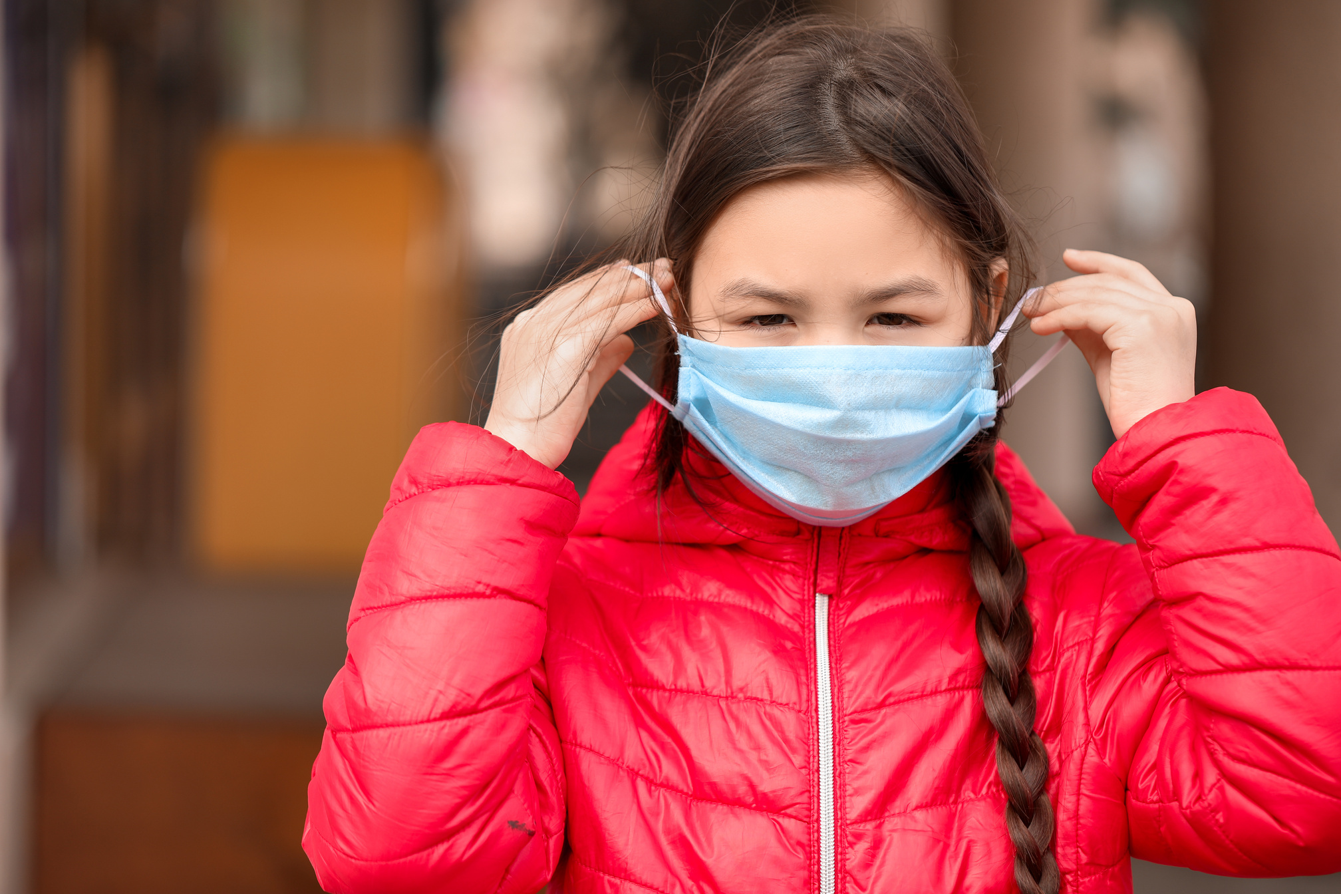
Improving air quality
Many lung conditions can be avoided by improving the quality of the air we breathe.
To help reduce air pollution, we can...
• Walk or ride a bike instead of getting a lift in a car.
• Share car journeys with others or use public transport, like buses and trains.
• Reduce online orders which are delivered by diesel vans.
• Buy and use less plastic and recycle rubbish whenever possible.
• Eat fewer meat and dairy products.
• Plant some seeds and care for trees and other plants.

Slide 20

Looking after our lungs
There are lots of things we can do to support good lung health. We can...
• Eat a healthy diet.
• Exercise our bodies.
• Avoid cigarette smoke and polluted air.
• Sing or play a musical instrument.
• Get help from a doctor if breathing is difficult.
• Follow medical advice if we have a lung condition.

Slide 21
so, look after your lungs!

